Slide 1
Jim Kooler, Dr.P.H. Kellie Goodwin
California Friday Night Live Partnership

Slide 3
There is a world of opportunities and challenges…

Slide 4
Evolution: Continuous Improvement Youth Engagement as Part of the Process
Youth have a unique expertise and perspective
Increases program credibility
Brings energy, enthusiasm, and honesty

Slide 5
Commitments to Youth: FNL Standards of Practice
Five

Slide 6
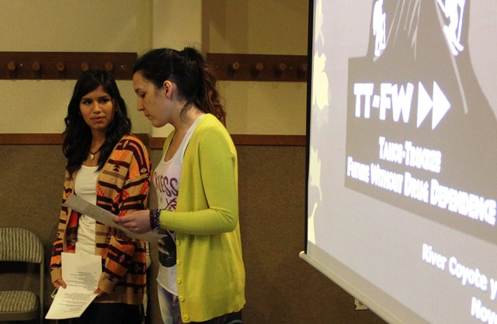
Safe Environment

Slide 7
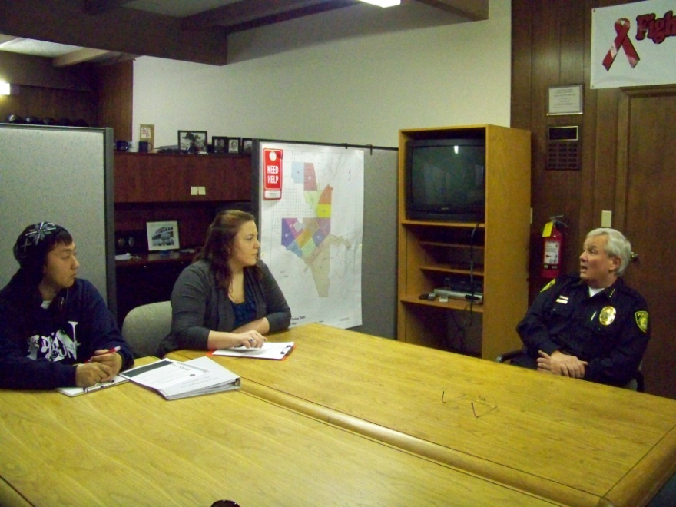
Opportunities for Leadership and Advocacy

Slide 8
Connected to School & Community

Slide 9
Caring Relationships

Slide 10
Skill-Building Activities Attractive to Youth

Slide 11
Social Host Ordinance
Frequency grew out of grant deliverables
Strategic Prevention Framework
State Incentive Grant
Drug-Free Communities

Slide 12
Flurry of Activity and Policies
Long history of working on policy
Youth partners in entire process

Slide 13
Influencing Behavior
Perception of risk of consequences
Social commitment to follow laws
Examples:
Safety belts
Speed limits
Smoking areas
Throwing trash from cars
Cell phones

Slide 14
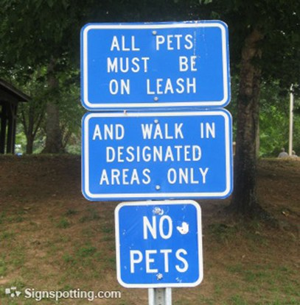
Mixed messages?

Slide 15
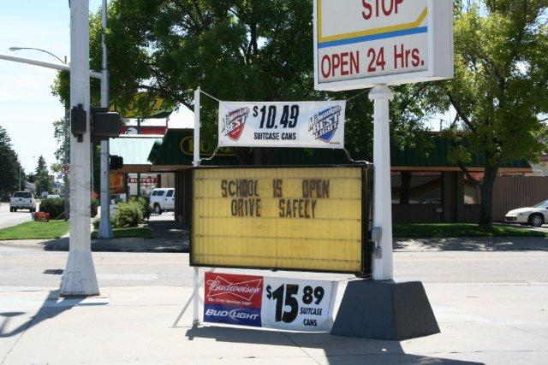
Really mixed message!

Slide 16
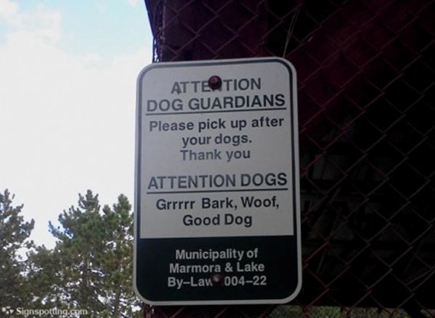
Messages to the right group?

Slide 17
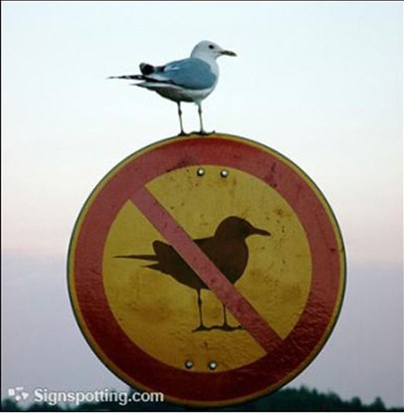
Does intended audience get the message?

Slide 18
Social host ordinance alone not enough.
Will to enforce, prosecute, and SUPPORT!
Continuous education on policy
Town Hall Meetings
Count Me In: Video and campaign
Complementary efforts
TRACE: Target Responsibility for Alcohol-Connected Emergencies
EFM: Every Fifteen Minutes
Lee Law: Store makeovers
Sober Grad

Slide 19
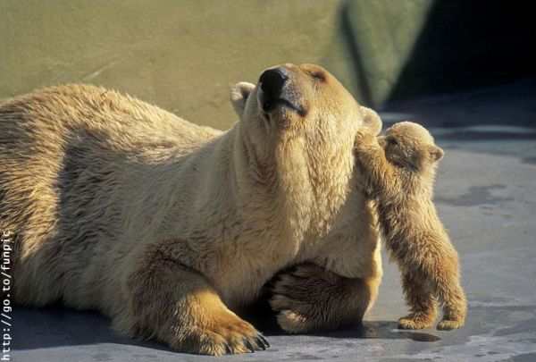
Time to listen to our young people.

Slide 20
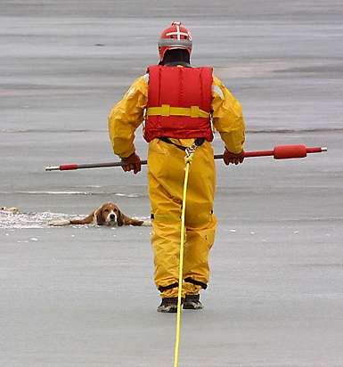
Willing to take the risk?

Slide 21
Can we make the environment safer?

Slide 22
Can we make the environment safer?

Slide 23
Can we make the environment safer?

Slide 24
jimk@tcoe.org kellieg@tcoe.org
559 733-6496
www.fridaynightlive.org

