Slide 1
Social Host Policy From Theory to Practice
Social Host Accountability To Reduce Youth Access to Alcohol
Michael Sparks M.A.
President – SparksInitiatives

Slide 2
Environmental Perspective
Targets the social, physical, or public environment where sales/use occurs.
Views alcohol and other drug problems not just as individual addiction, but rather as the collective reflection of community norms and practices.
Targets are decision makers and others with authority to change environments.
Seeks to change physical, legal, economic, & social processes of communities.

Slide 3
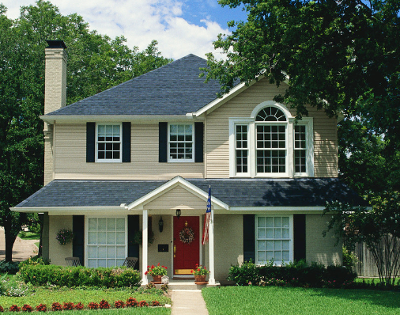
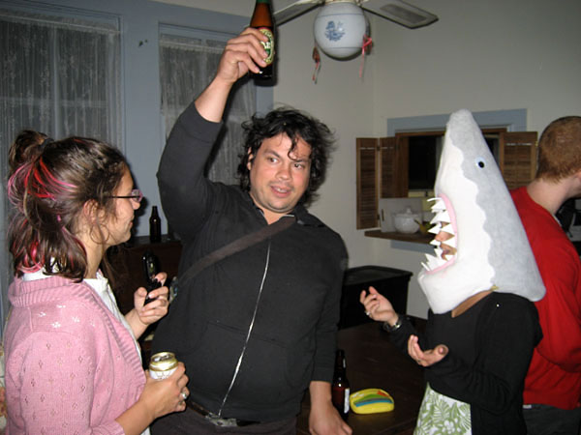
Problem Setting: Home Parties
Son held drunken party for 600 friends after banishing parents to bedroom of their multi-million-dollar mansion
By Mail Foreign Service
UPDATED: 20:55 EST, 14 October 2010

Slide 4
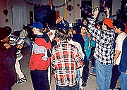
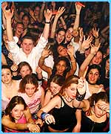
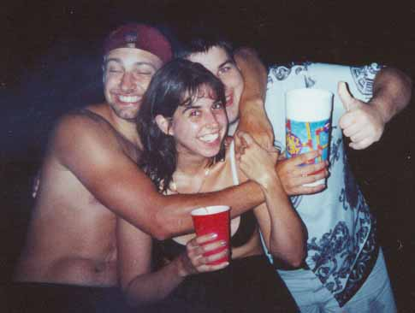
A Setting for High-Risk Drinking

Slide 5
Source of Alcohol Among
Ever-Drinkers
Age
Unweighted data; last drinking occasion; (N=11,203); EUDL-CT data
Notes:
Despite laws in most states that restrict possession of alcohol by youth, alcohol is easy to get. This is data from the EUDL-CT study and is representative of how adolescents typically obtain alcohol. Primary source for all age grps is social; but retail increases with age
Other: don’t know, found it, was just there…
FROM EUDL_CT
Social sources are the main source of alcohol for drinkers under 20. It tends to decrease with age, as commercial sources tend to increase.

Slide 6
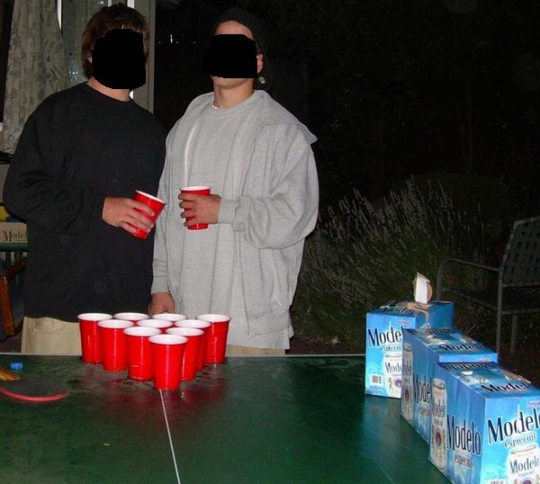
Why do we care about the setting?
Drinking Context is Important!
Parties are high-risk settings for binge drinking and consequences.
Alcohol provided or at low cost per drink.
Often unsupervised or with parental permission.
Increased risk for DUI, riding with drunk driver, sexual assault, violence, and injuries.

Slide 7
Home Parties
Large underage drinking parties provide a social context where young drinkers may be introduced to heavy drinking by older, more experienced drinkers (Wagenaar et al., 1996).
Larger parties appear to be especially risky among high school students; those consuming 5 or more drinks on the last drinking occasion were more likely to report being in a group of 11 or more (Mayer et al, 1998).

Slide 8
Using Social Host To Address
Home Parties

Slide 9
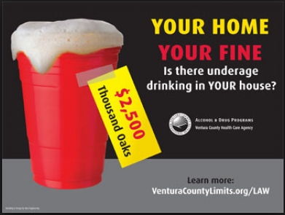
Social Host
Laws at the state and local level that hold property owners, parents, and adults accountable for underage drinking occurring at their home.
Many focus on the “hosting” of a party as opposed to provision of the alcohol at the party.
Consequences are often civil or criminal in nature.

Slide 10
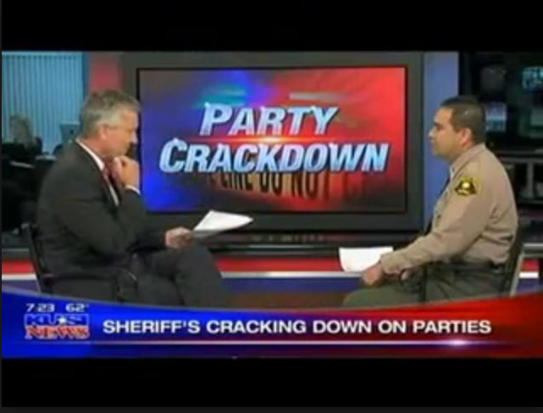
Social Host Intent
Change community CULTURE and CONDITIONS
Change the FOCUS from underage drinker to provider/enabler
Decrease PROVISION
  Decrease furnishing of alcohol to an underage person
Change CONTEXT and SETTING
  Deter underage drinking parties

Slide 11
What is social host liability?
Social host liability refers to laws that hold non-commercial individuals responsible for underage drinking events on property they own, lease, or otherwise control.

Slide 12
Types of Social Host Liability
Civil/tort liability
Criminal
Civil/cost recovery

Slide 13
Type 1: Civil/Tort Liability
Laws and court opinions that allow third parties to sue social hosts for damage caused by minors who consumed alcohol on the host’s property.

Slide 14
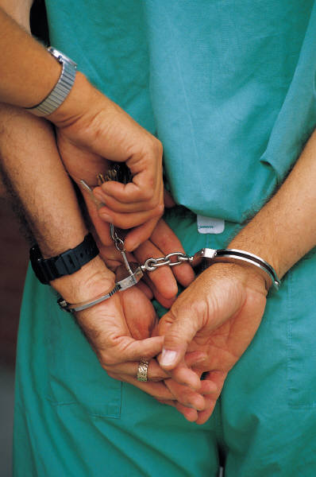
Type 2: Criminal Statutes
Social host laws that impose criminal sanctions (fines or imprisonment).
Criminal prosecution requires strong evidence of wrongdoing.
20 states have enacted criminal social host laws.

Slide 15
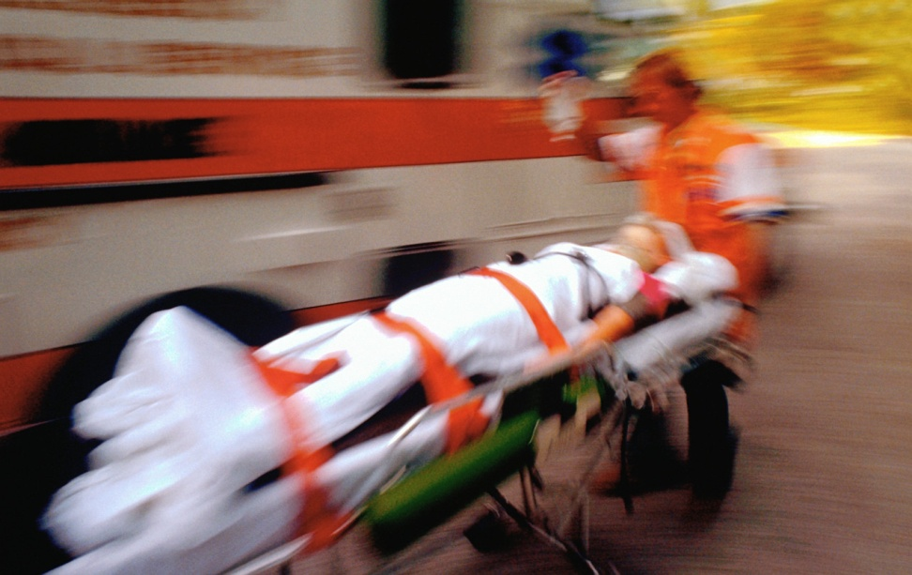
Type 3:Civil/Cost Recovery
Treats underage drinking parties as a public nuisance and threat to public safety.
Imposes an affirmative duty on home owners to prevent parties from occurring.

Slide 16
Type 3:Civil/Cost Recovery (cont.)
Imposes civil fines, including possible reimbursement to local government for cost of law enforcement and emergency services.
May include landowners, landlords, tenants, and hotel and motel operators.

Slide 17
Civil Social Host Liability
Hosts are prohibited from providing a location for underage drinking events.
Furnishing the alcohol is not a required element of the offense.

Slide 18
Advantages of
Civil/Cost Recovery Laws
Strict liability – no knowledge requirement.
Fines imposed administratively, not through criminal justice system.
  Quicker, more certain process, and
  Greater likelihood that punishment will be imposed.
Promotes shift in community/social norms.

Slide 19
Social Host Ordinances:
Key Drafting Decisions
Type of ordinance
Level of knowledge required for violation to occur
Persons potentially liable
Number of notifications and time period
Amount of fines and inclusion of cost recovery

Slide 20
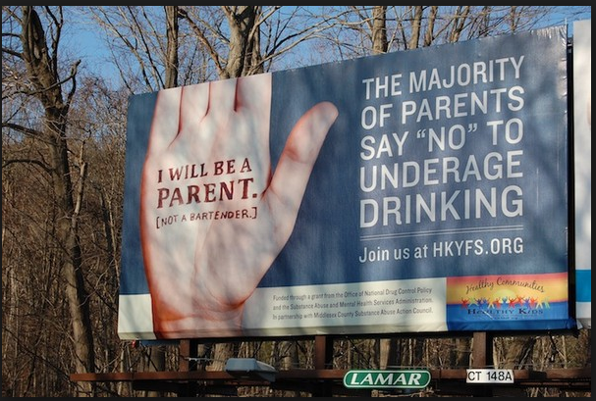
Social Host: Evidence From Small-Scale Studies and Evaluations
May result in fewer calls for service:
  Petaluma, CA had 9.3% fewer calls for service related to disturbances from the year prior to passage (2006) to the second year after passage (2009) (Petaluma unpublished data, 2009).
San Diego County had 8% fewer disturbance calls from the year preceding passage (2002) to the year following passage (2004) of its SHO (UDETC, 2003).

Slide 21
Contact Information
Michael Sparks
Michael@sparksinitiatives.com

